Slide 1
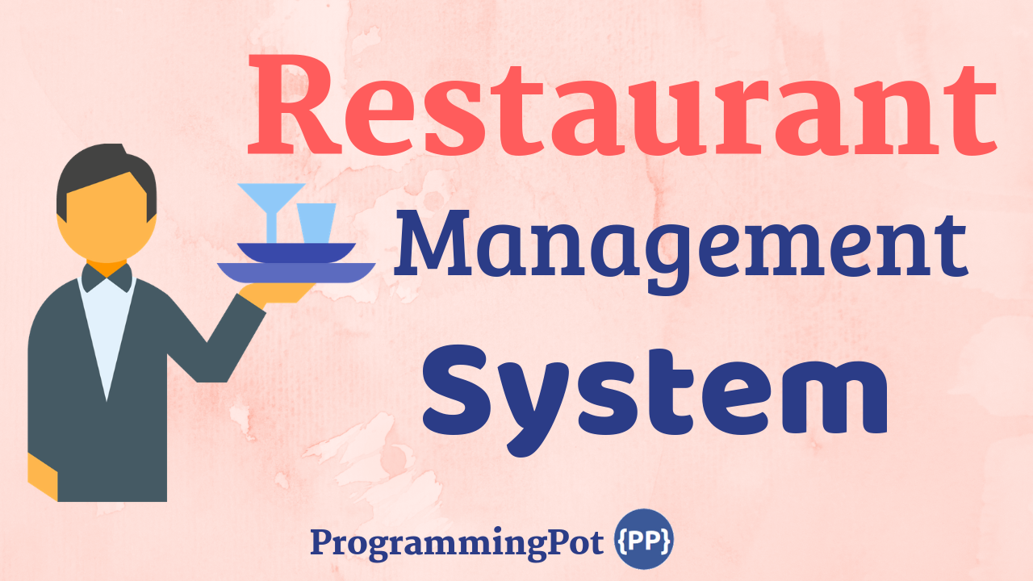

Slide 2
HumanManagement
Restaurant
- name: string address: Address - manager: Manager
Address
street: string city: string
1
CategoryManagement

Slide 3
HumanManagement
*
Abstract Person
# id: number # name: string # age: number # phone: number
Customer
*
Waiter
*
Staff
- salary: number
1
Manager
gender
1
<enum> Gender
MALE FEMALE OTHER
Chef
category
1
*
<enum> StaffCategory
WAITER MANAGER CHEF RECEPTIONIST
Receptionist
*

Slide 4
CategoryManagement
<enum> MenuCategory
MEAL, BEVERAGES
TableType
CIRCLE, RECTANGLE, SQUARE
Table
1
1
Menu
*
Table
+ tableId: number
*
Order
+ orderId: number + chairId: number + menuItemId: number
Menu
+ menuId: number + itemName: MenuCategory
*
Chair
+ chairId: number + tableId: number + customer: Customers
*
1
MenuItem
+ menuItemId: number + itemName: string + drinks?: Drink + price: number
1
Payment
paymentId: number billId: number
Bill
billId: number totalBill: number orderId: number
<enum> PaymentSection
CASH CARD
1
1
1
Cash
Card

